Slide 1
Strategies for Scaling and Impact
Farmfit Insights Hub
21 June 2023
AMEA Global Convening

Slide 2



Recap: the problem in our sector
We need massive investment in smallholder agriculture
Private sector to play a key role
Evidence and data on models & approaches that work

Slide 3



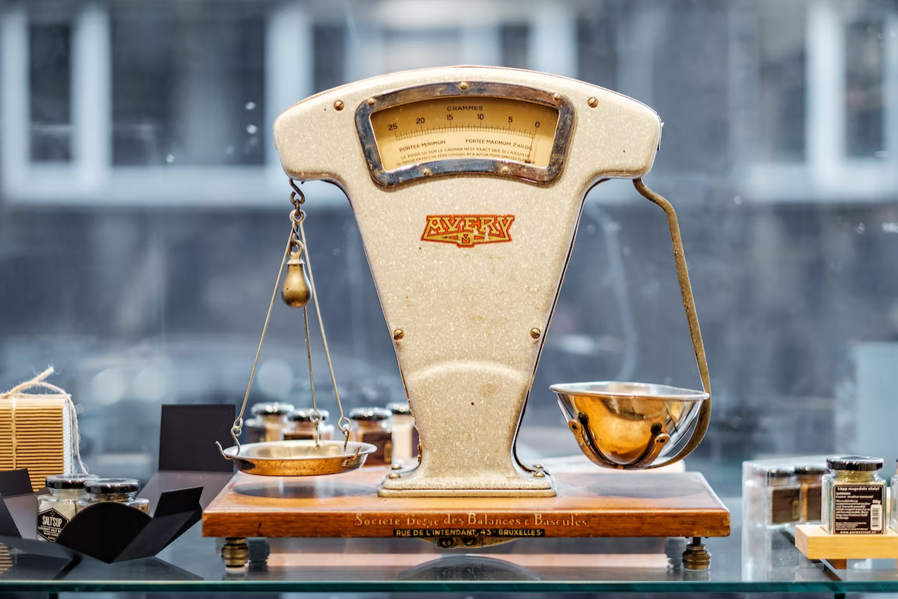
We often lack the information to decide
LANGUAGE
WHAT IS SUCCESS
METRICS
COMPARISON
Sources: Kane Reinholdtsen, eskay lim, Miikka Luotio, Piret Ilver on Unsplash

Slide 4
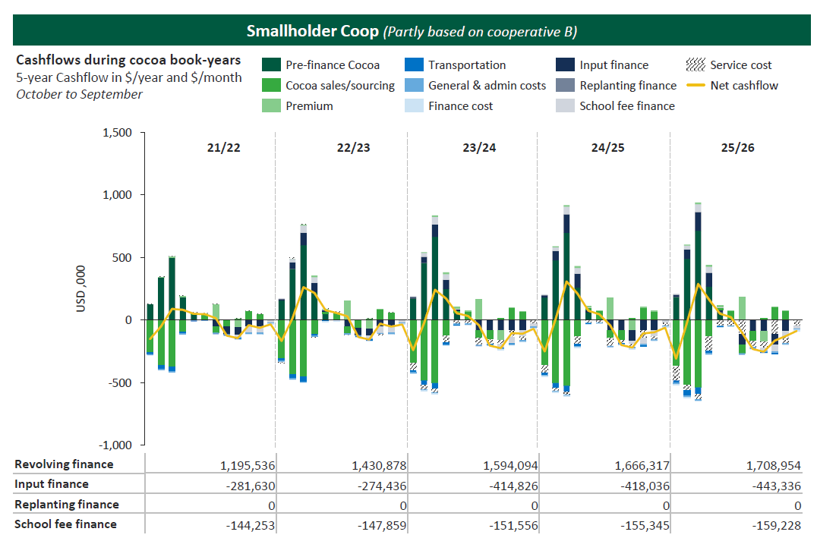
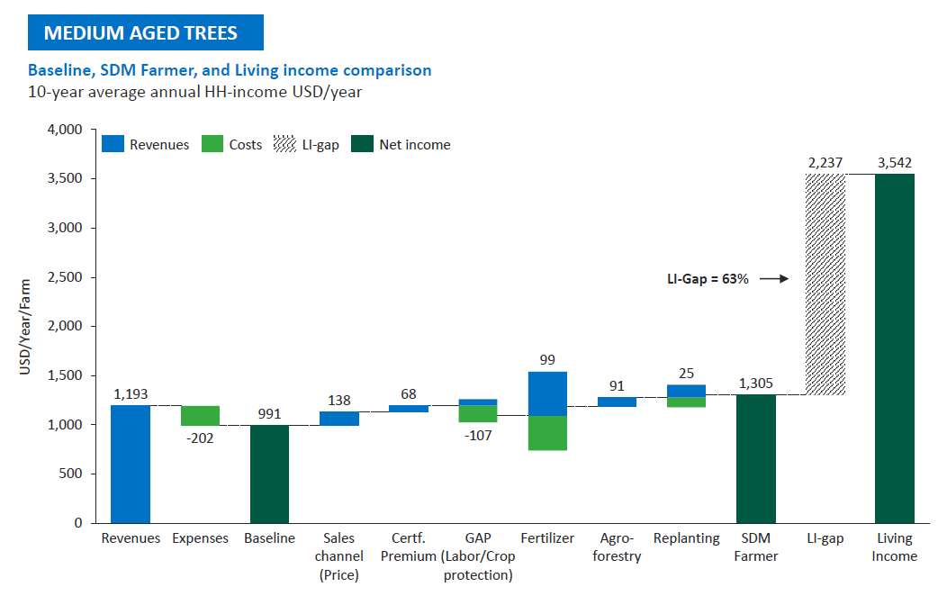
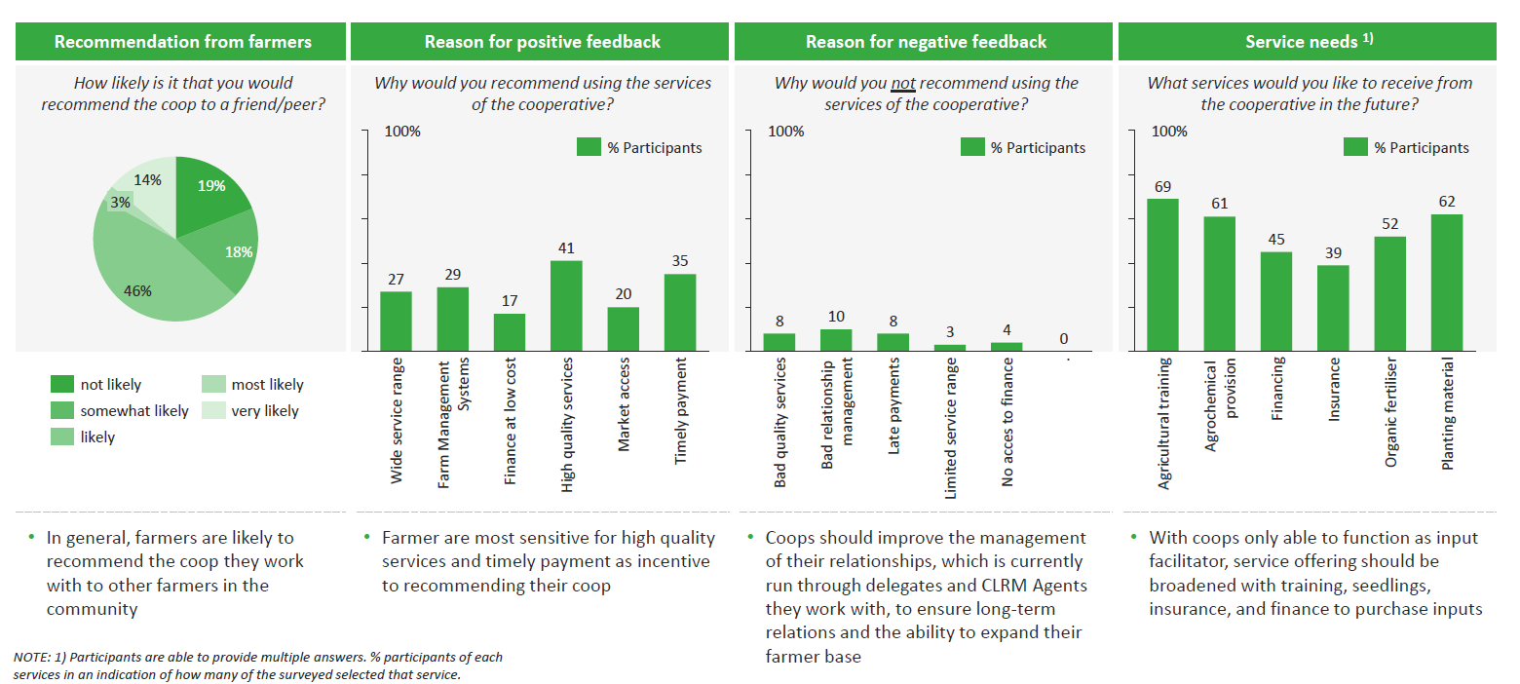

Our work has involved analysing business models for over eight years
More reports at: bit.ly/SDMreports

Slide 5
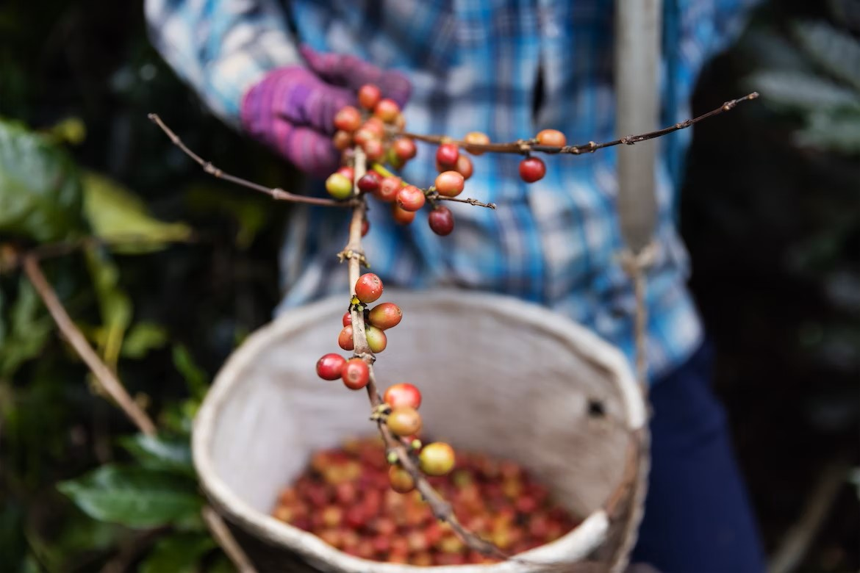
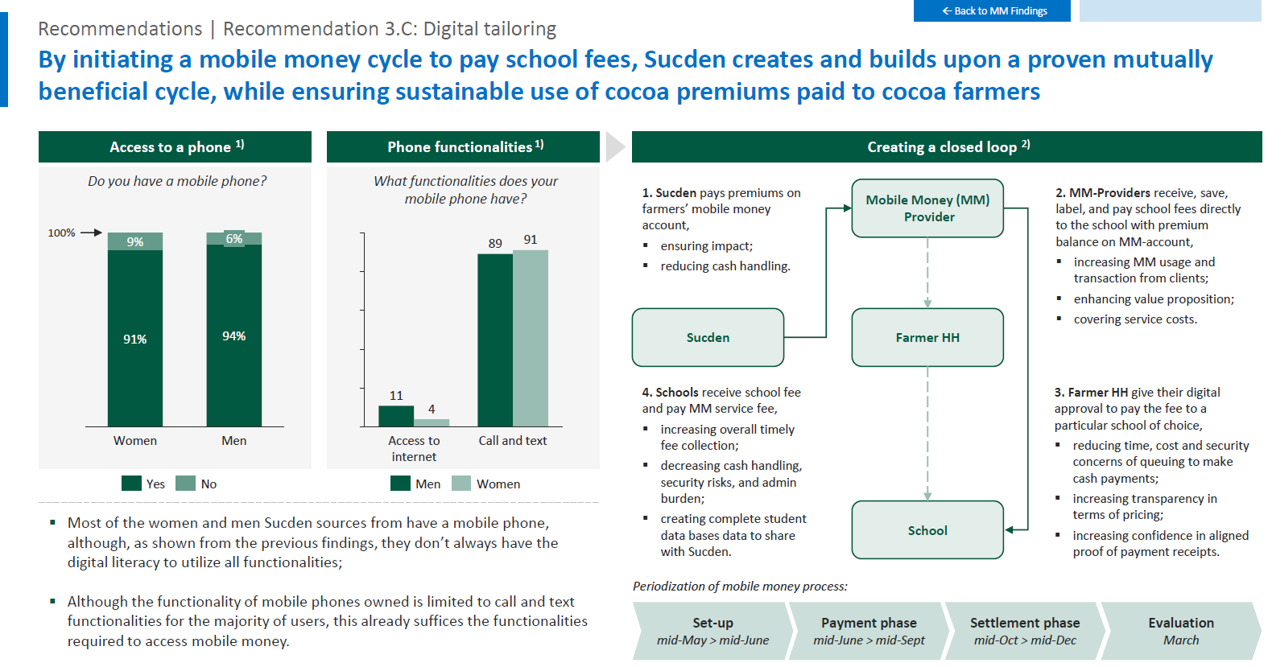
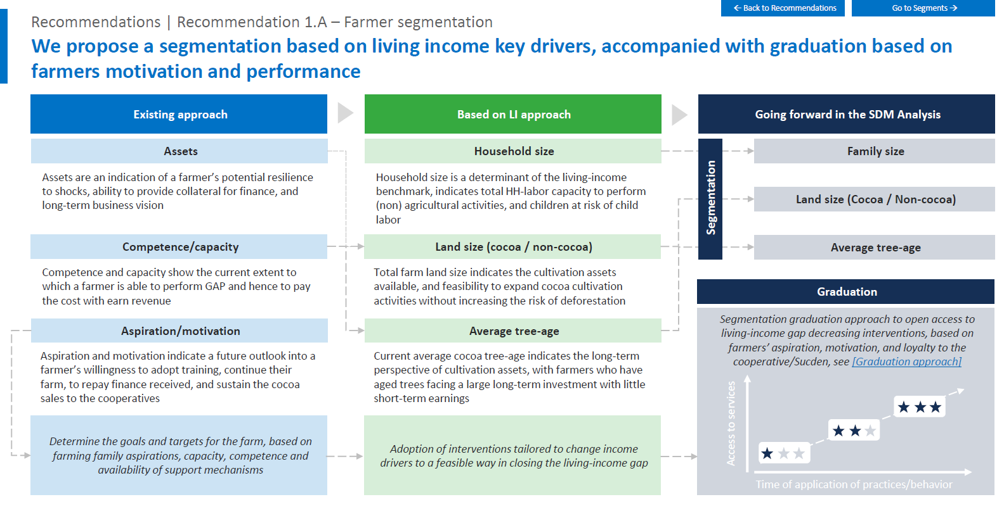
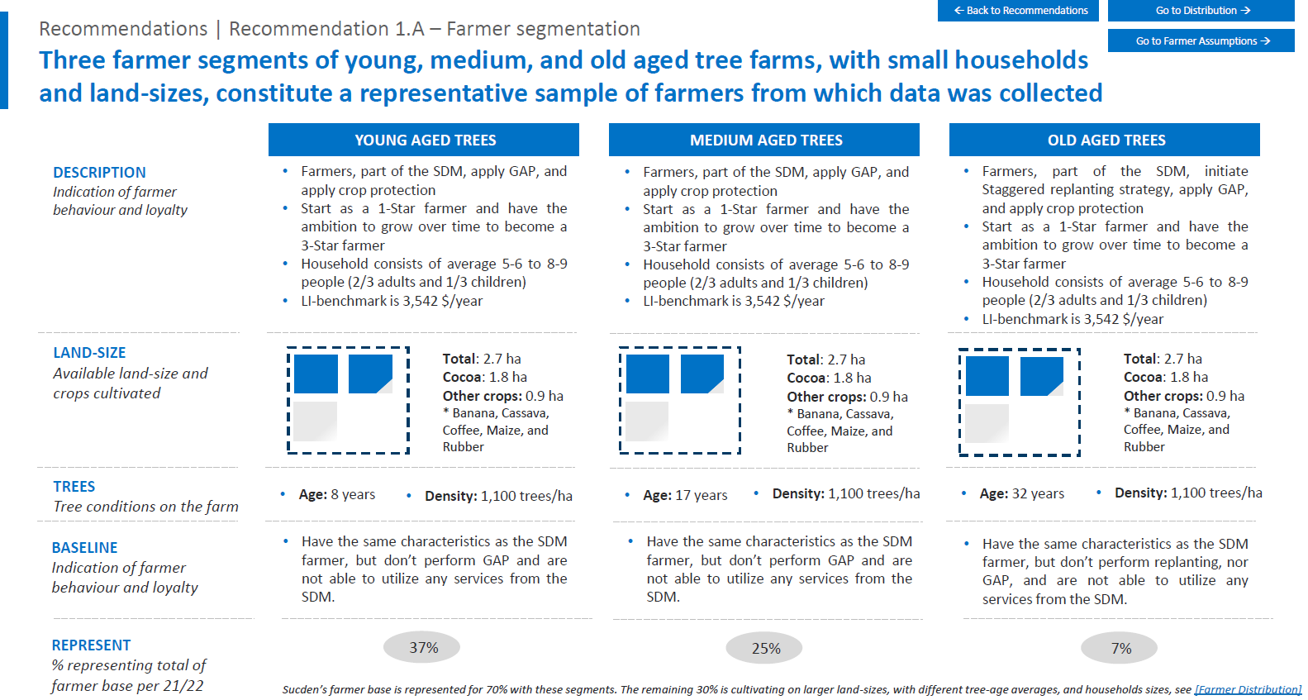
Each of these analyses provides us with a wealth of standardized data
Drivers
Value chain
Coffee
Scale
15,000 farmers
Primary markets
Intercontinental
Model complexity
High
Value chain organization
Tight
Last mile delivery
Lead farmers
…
…
…
…
Outcomes
Farmer value created
+$250/year
Investment per farmer
$130 / farmer / year
Cost recovery
10%
…
…

Slide 6



























We have collected over 2mn data points using this approach since 2015
100+ models
25+ countries
25+
crops

Slide 7
Semi-standardized analytics inform value chain development and aggregate insights production
Business Model Analysis
Value Chain Development
Aggregate Insights Production
Assesses the context, business model design, business case and impact case of a company
Provides detailed recommendations that can be used to inform TA & BDS
Facilitates comparisons across business models from varying contexts to identify patterns & best practices
Allows internal and external parties to learn from others

Slide 8


We seek to scale our approach both through value chain transformation and insights
The Service Delivery Model Assessment (SDMA) does not provide detail on all relevant aspects
At the same time, the Farmfit TA approach has shortcomings at a systems level (finance, FO’s)
With agriGRADE we plug into a collaborative approach to better transform the system
We have collected a wealth of data from over 100+ business model assessments but have not yet answered many key questions on smallholder-inclusive business models
The Farmfit Insights Hub provides directional answers to what works well, where and why with regards to smallholder inclusion

Slide 9
With the Farmfit Insights Hub we dive into our data to answer the following questions
What defines
successful service delivery to SHFs?
Farmer Value Created
Investment per Farmer
Cost recovery
What
drives
successful service delivery to SHFs?
~50 drivers
Context
Design

Slide 10
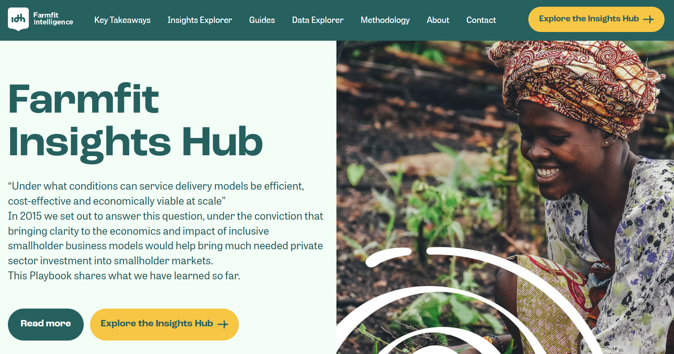
We’re currently finalising a first version, but here is a sneak peak

Slide 11
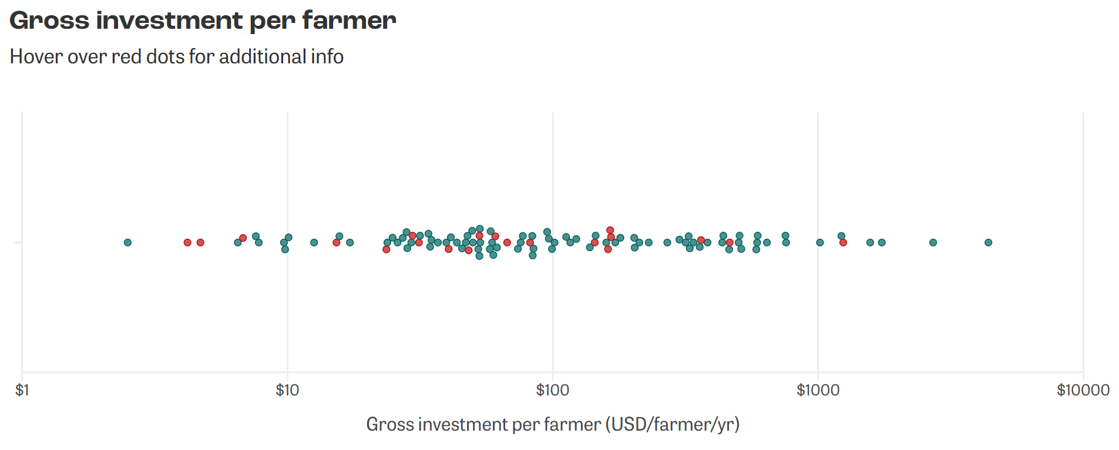
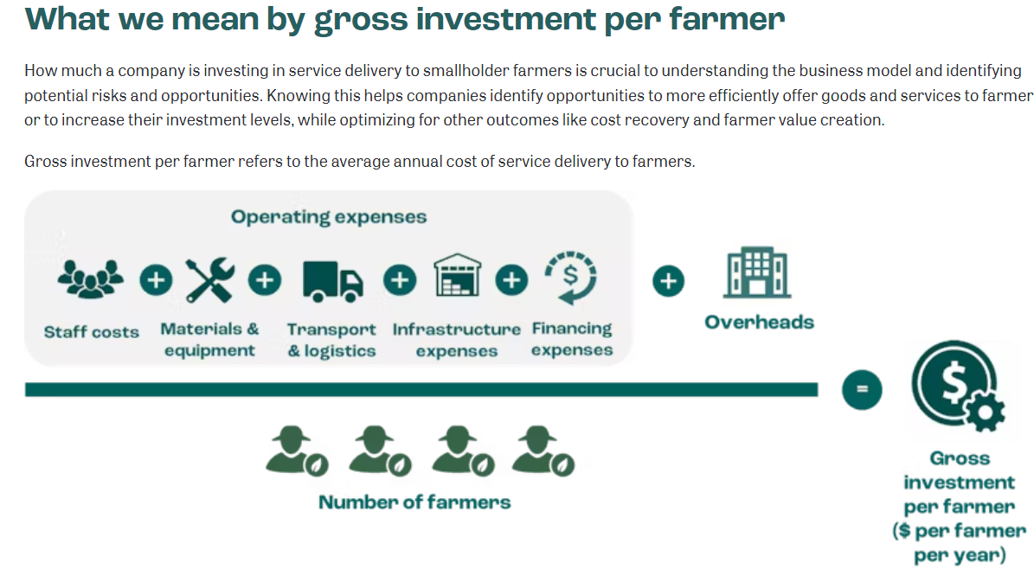
Our analysis provides an overview of how different business models have performed

Slide 12
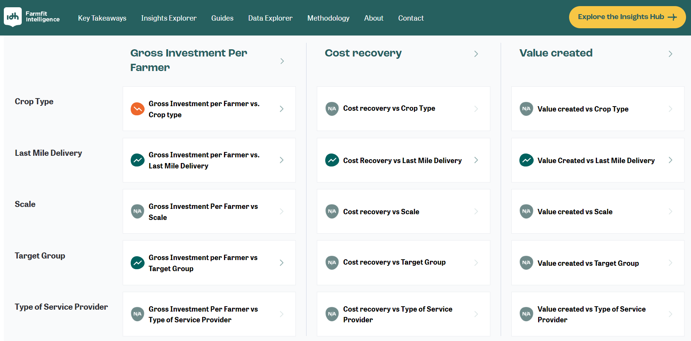
We assess how key drivers relate to performance outcomes

Slide 13
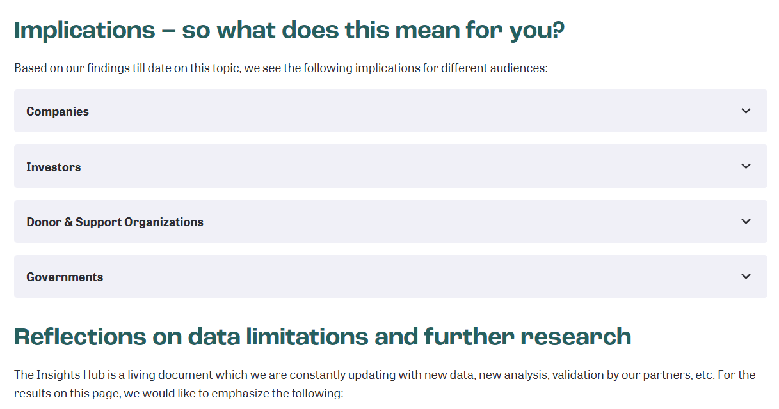
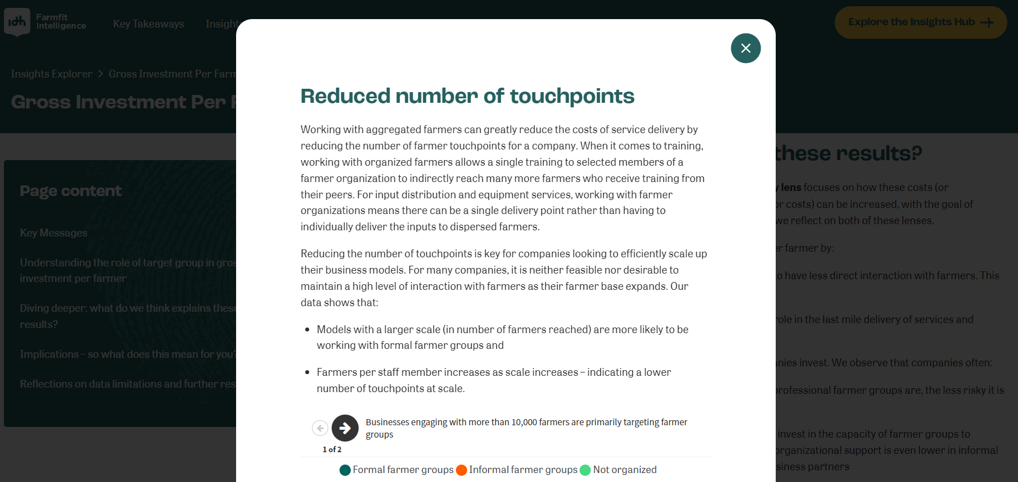
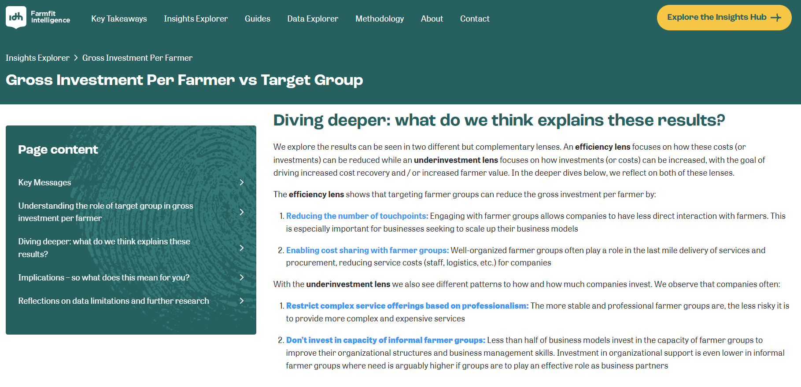
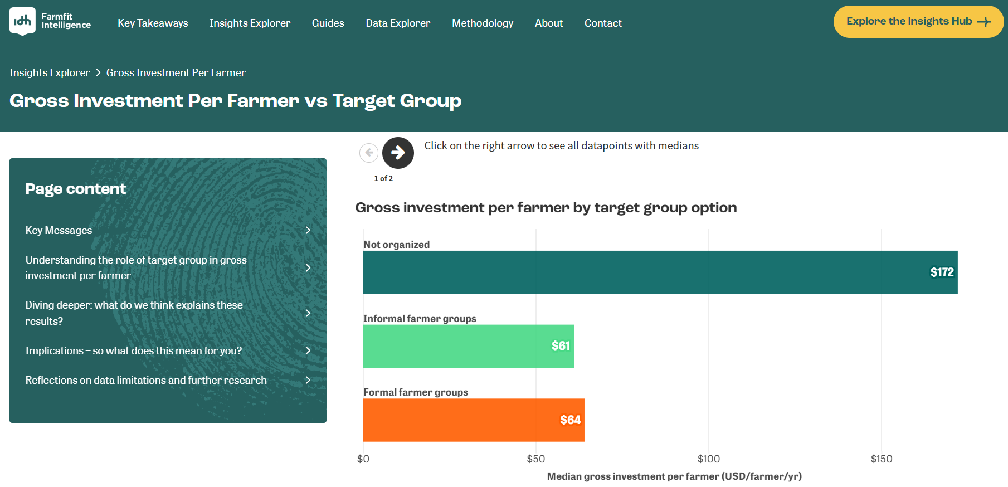
Then we dive deeper to understand what drives the relationship between drivers and outcomes

Slide 14
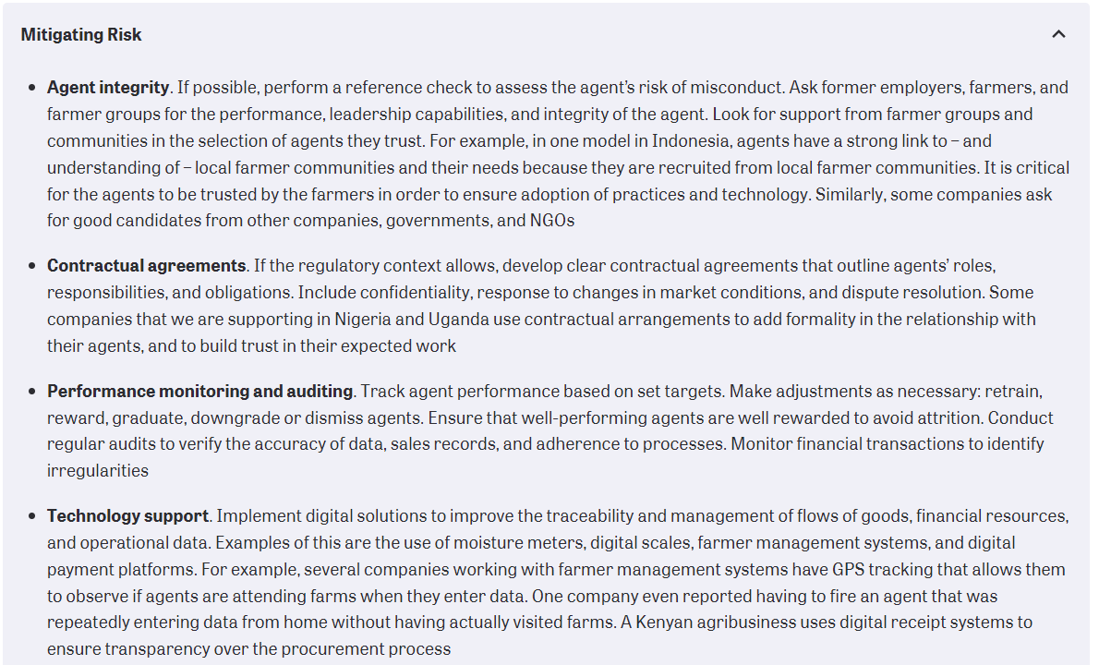
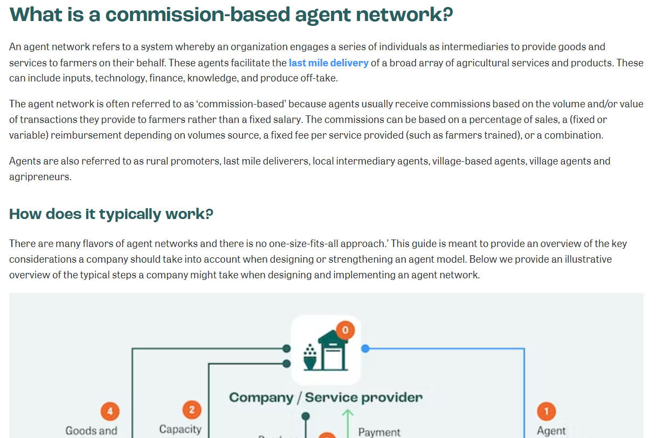
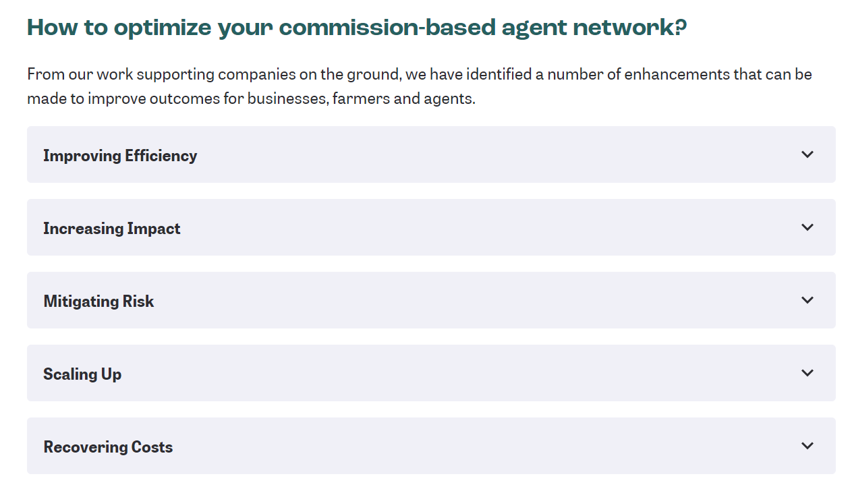
And we complement these analytical insights with practical guides and case studies

Slide 15





… and hope it will add value to a wide range of sector actors
BUSINESS
INVESTOR
SUPPORT ORG
GOVERNMENT
FARMER
Stronger smallholder-inclusive business models
Better investment decisions
More effective and relevant BDS
Better targeted public interventions
Improved income, resilience, and inclusion

Slide 16
There are a few factors that influence the potential for scaling
Constraints
Enablers
AMEA Opportunities
Amount, relevance, sensitivity and quality of data
Costs (analyses, data infrastructure, insights production)
Willingness to pay (analyses, research, events, methodology)
Standardization of full approach
Ongoing modularization of SDM Analysis
Holistic learning driven approach to assess
Sophisticated data infrastructure allowing for APIs and sharing
SDM Analyses available via the toolbox
Licensing/sharing of SDM methodology
Opening the Farmfit Insights Hub up to co-contributors
Further localisation of team & better integration with local networks

