Slide 1
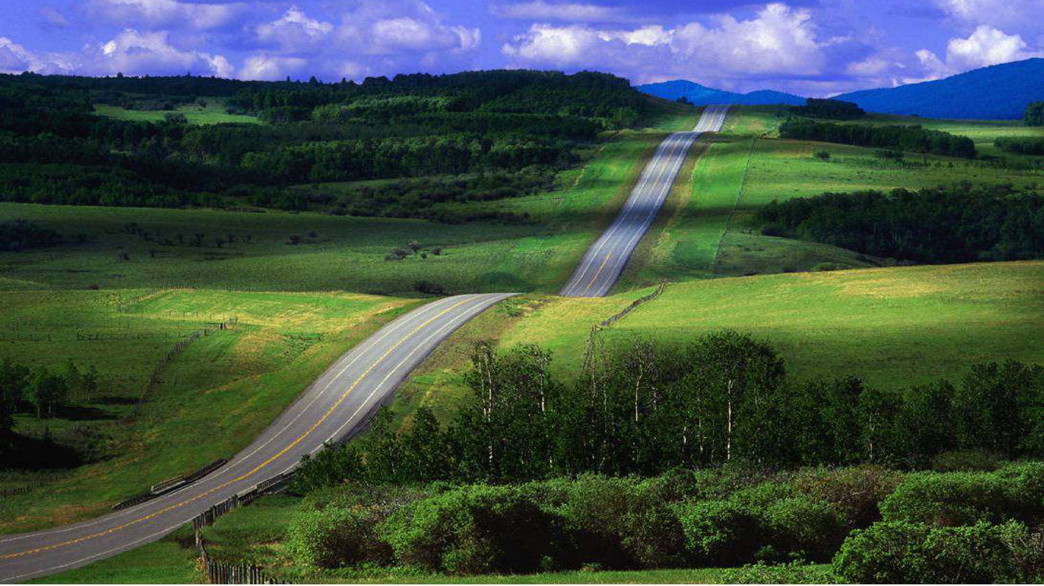






AgriGRADE: Graduating the Cooperative landscape

Slide 2

Key features: For an effective scalable approach, stakeholders have a specific role based on their expertise and common data makes it interoperable
1. Digitize, data insights
2. Targeted BDS tailored to needs
4. Facilitate access to finance and markets
3. Value Chain development
©AgriGRADE | All rights reserved
2

Slide 3
To graduate the cooperative landscape in a country or sector, we follow these 5 steps
1
Scoping of the cooperative landscape
2
Analyze and segment
3
Assess, graduate, monitor and improve
4
Improve service delivery value chain performance
5
Link advanced cooperatives to finance, inputs and markets
©AgriGRADE | All rights reserved
3

Slide 4
Key features: The scoping allows segmenting cooperatives as each segment has specific BDS needs
BDS system
BDS partners need to demonstrate at what level their expertise lies
The curriculum is not prescribed.
It is the result that counts
Level 4: Top producers
Star
performers
Level 3: Advanced
Professional cooperatives
Level 2: Advancing
Advancing cooperatives
Level 1: Basic
Starting and emerging cooperatives
©AgriGRADE | All rights reserved
4

Slide 5
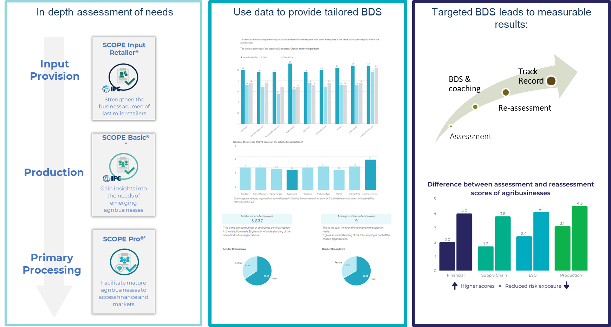
Key features: data-driven graduation leads to market-led and measurable results
Curriculum agnostic
©SCOPEinsight - All rights reserved
Notes:
Initial text for step 3:
More mature agribusinesses: reduces risk!
Re-assessment SCOPE Scores provide a track record and an indication of bankability (proxy credit rating)

Slide 6
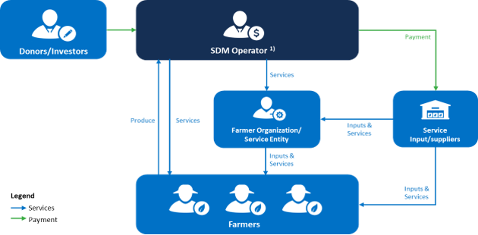
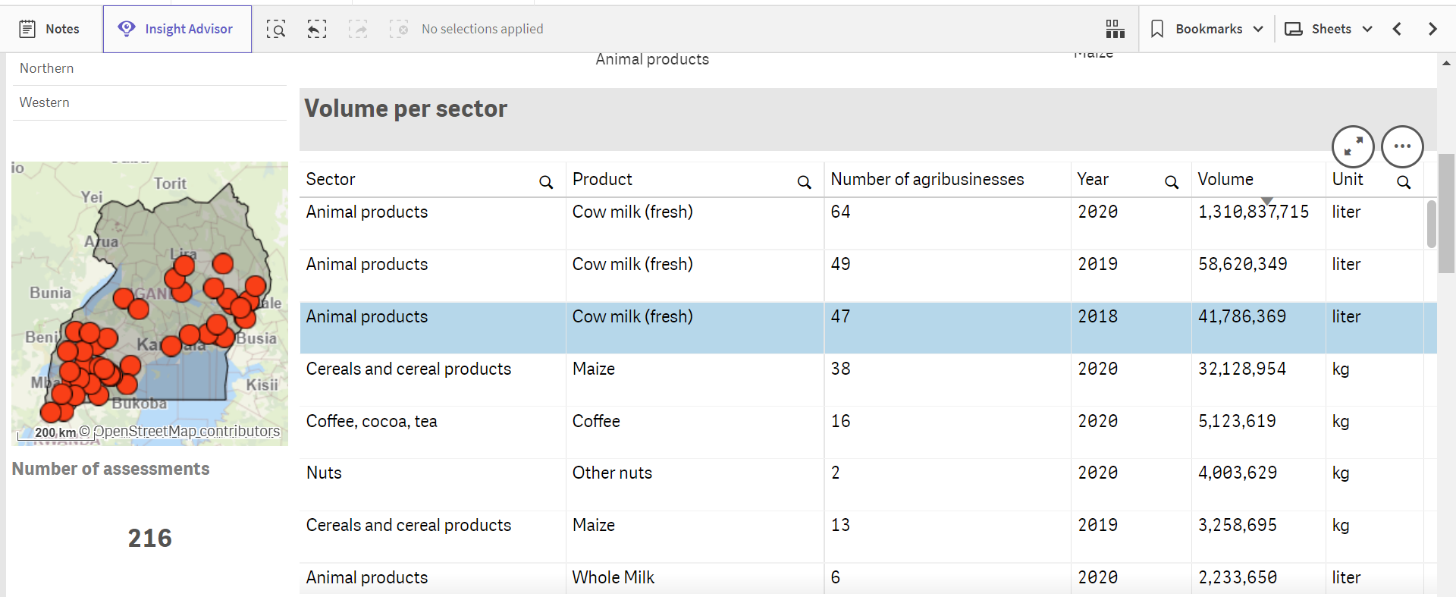
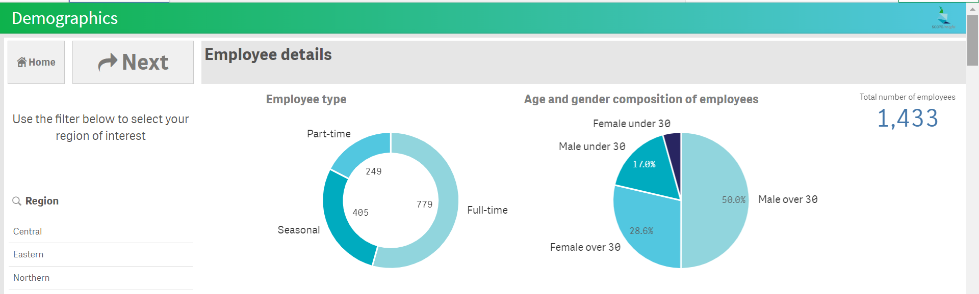
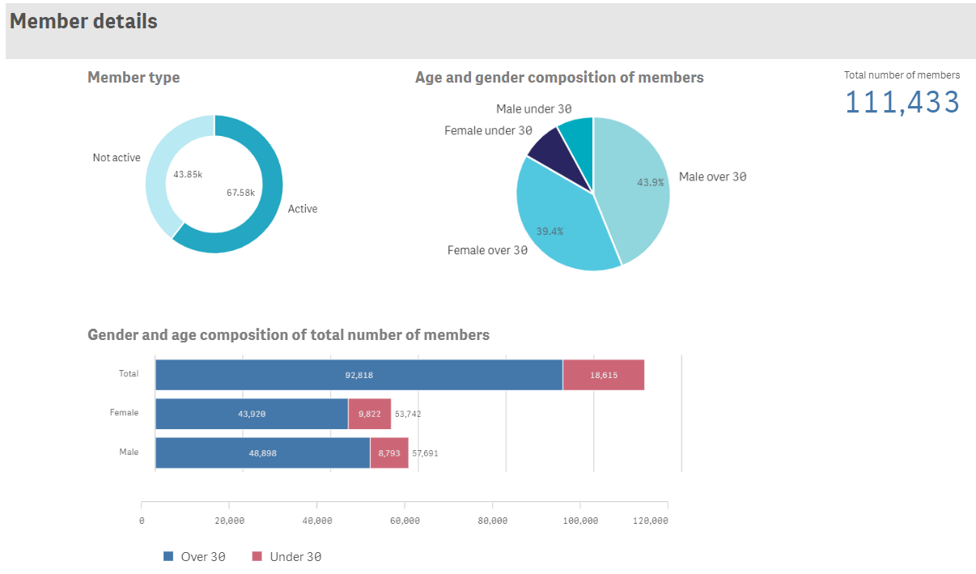
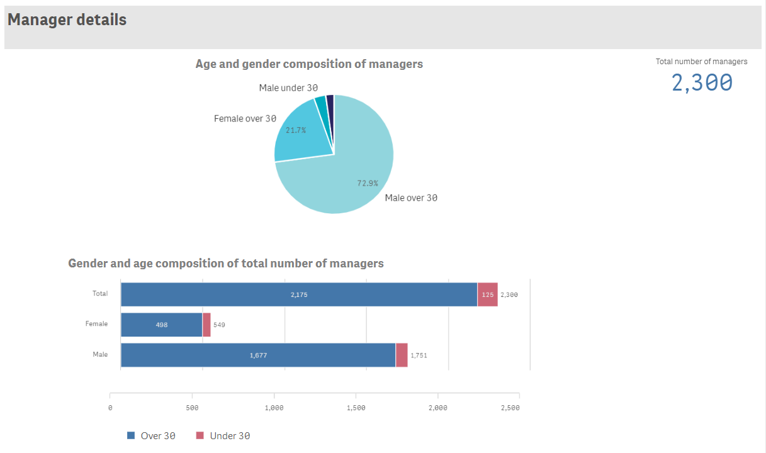
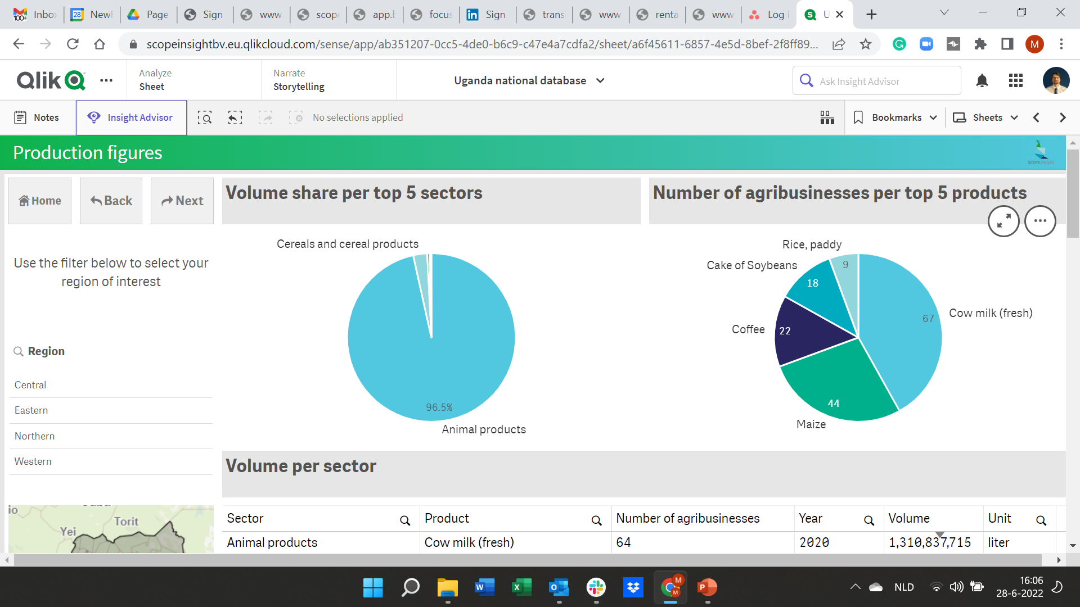
Key features: Service Delivery & Business Model analysis to strengthen the value chain
Prive Sector
Private Sector
Analysis of SDM Data
combined with SCOPE Data
Starting and emerging cooperatives
©SCOPEinsight - All rights reserved
Notes:
Initial text for step 3:
More mature agribusinesses: reduces risk!
Re-assessment SCOPE Scores provide a track record and an indication of bankability (proxy credit rating)

Slide 7


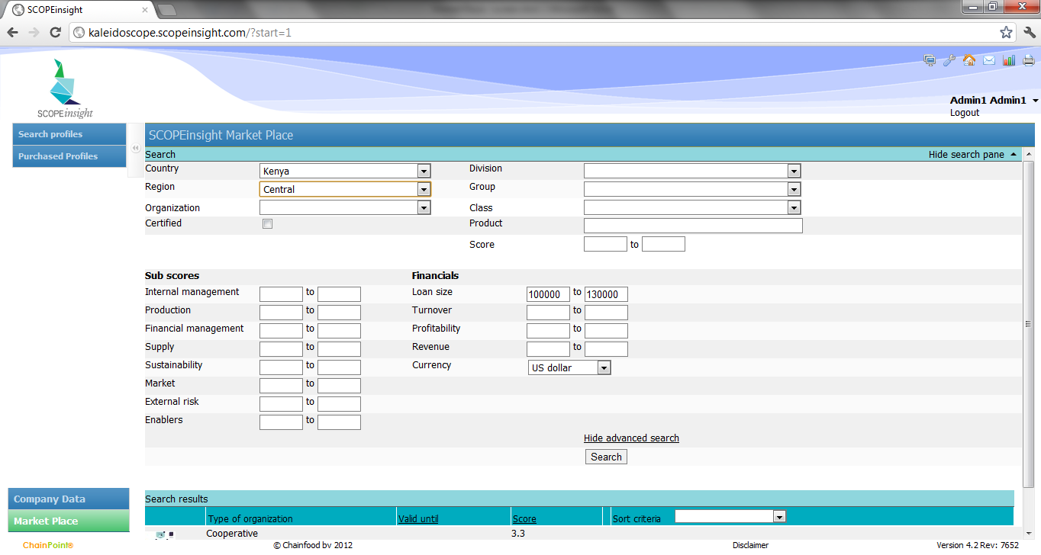

Key feature: Presenting a growing pipeline in a standardized way*, we can link cooperatives to lenders
Assessment Data
The SCOPE Portal
Lenders
Funds
Social Lenders
Commercial Banks
MFIs
SACCOs
Pilot ready
* Based on the Bankability Metrics developed by CFI and SCOPEinsight thanks to AGRA
7

Slide 8
Key feature: Collaborating in this way, over time the cooperative landscape graduates in a sustainable way
4
3
2
1
10 FOs
15 FOs
20 FOs
40 FOs
85 FOs
130 FOs
150 FOs
200 FOs
250 FOs
300 FOs
200 FOs
100 FOs
Year 1
Year 3
Year 5
Uganda: An example: 500 cooperatives are assessed on their levels of professionalism
Outcome: A national database with four segments of cooperatives
BDS trajectories per segment, give tailored support and graduate agribusinesses to next levels
©AgriGRADE | All rights reserved
8

Slide 9




Key features: AgriGRADE involves other (local) partners and platforms, so it is open to building partnerships
Governments
(Local) financial institutions
Apex organizations
BDS providers
Private Sector
©AgriGRADE | All rights reserved
9

Slide 10
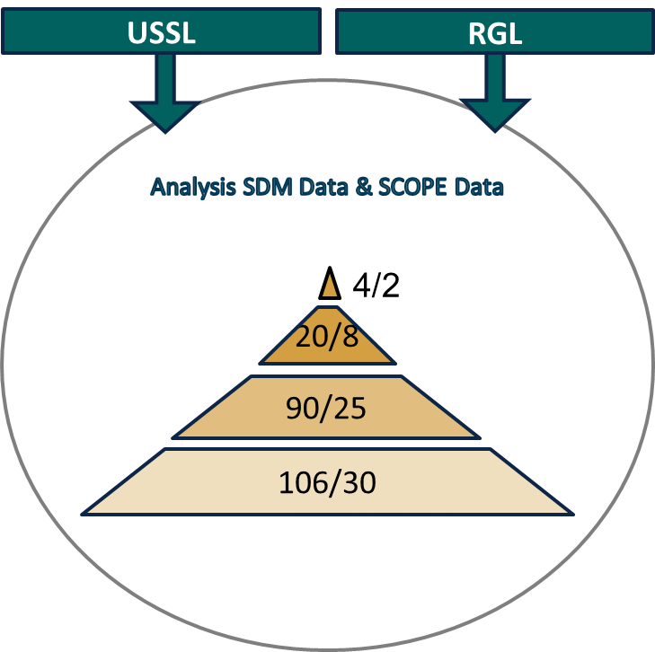
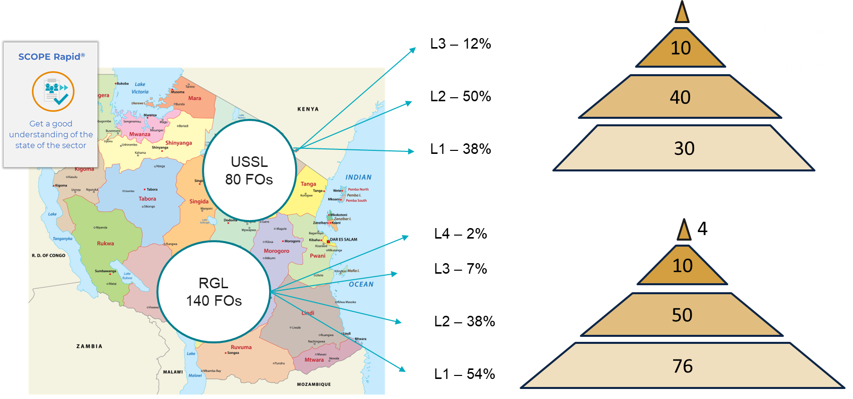
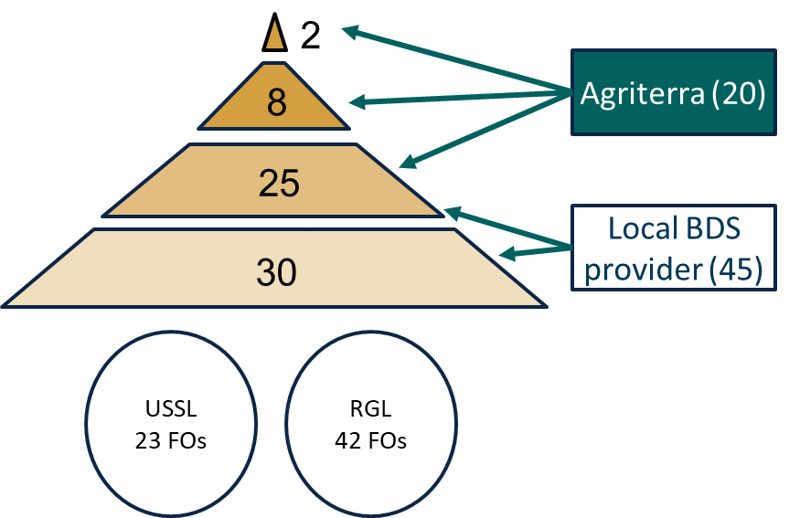
AgriGRADE pilots: to provide proof of concept
Selection

Slide 11
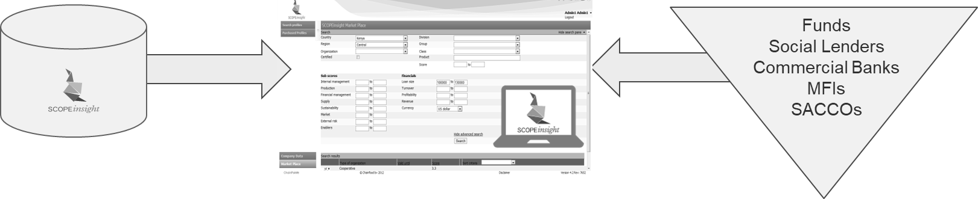
AgriGRADE pilot: Access to Finance is an important goal
A2F Target (new loan or increased loan):
±80% of level 4 = 4 coops
±50% of level 3 = 7 coops
±30% of level 2 = 9 coops
±20% of level 1 = 4 coops
Total: 24 coops (35% of the 65)
5
14
Professional cooperatives
27
Advancing cooperatives
19
Starting and emerging cooperatives
©AgriGRADE | All rights reserved

Slide 12
To recap the key features:
Specific roles for each partner based on experience & expertise
Common data & tools, aligned to standards¹, to make it interoperable
Segment the cooperatives and dare to select
Target BDS to needs by using data insights to deliver measurable results
Combine datasets to enhance insights
Deliver a systematic approach by building a local ecosystem others can benefit from
Deliver a growing pipeline of eligible cooperatives in a standardized format² and onboard financiers who can act on it
Open to partnering with organizations and programs that share the same vision
Common data is aligned to the IWA29
Based on the Bankability Metrics
12

Slide 13

Targeted segment:
Types of financiers
and loan sizes
AgriGRADE targets:
Agribusinesses:
  Farmer Organizations
  Cooperatives
  Agri-SMEs
Input Retailers
SACCOs
AgriGRADE aims to address the Hidden Middle
Banks
Fund
Social Lenders
MFIs
SACCOs
Commercial Banks
Social Lenders
Loan sizes often min $500k
Hidden Middle
Financing need between $50k and $500k
Hidden Middle
SACCOs
MFIs
Agribusinesses with
financing needs
13

Slide 14
Strategies to scale:
Elements of AgriGRADE have been proven,
other elements co-developed and piloted¹
Dutch Foreign Affairs plans to fund the launch of AgriGRADE for the first 3.5 years
        Center of Excellence
        Two pilots
AgriGRADE Business Development coordinated by the Center of Excellence
        CoE, AgriGRADE Partners & Ambassadors
        Ecosystem: movement of aligned partners
        Regular Business Development
        Open to explore AgriGRADE inspired approaches in win-win partnerships
AgriGRADE
Center of Excellence
AgriGRADE
Pilot in Tanzania
AgriGRADE
Pilot in Kenya
Future AgriGRADE programs
AgriGRADE alignment between programs
AgriGRADE inspired approaches
1. Also thanks to AMEAs Tool Improvement Facility
14

Slide 15
Enablers and constraints:
Enablers | Constraints
Donors support initiatives that aim to provide proof of concept of systemic approaches where different partners can align and scale up | The doner-driven project-by-project approach
Partners using a standardized format and onboard financiers | Development sector and the financial sector operating in silos
Governments take responsibility and take ownership | Governments expect receiving financial support
Well-functioning BDS system | Fragmented approaches
Private sector partners who wish to expand their local sourcing or wish to strengthen their value chain
 | Donor driven KPIs leading a program
Ensure that there is an ecosystem in place that can take over when a program finished | Lack of an exit strategy
15

Slide 16
How can AMEA help to grow?
Globally:
Identify opportunities for the use of standard tools
Advocate standards: IWA29 & Bankability Metrics, ad use of common data
Lobby with donors to get them to support a systemic approaches
Explore how the cost of BDS can be decreased
Locally:
Help build local BDS systems, with an independent quality seal
Lobby with local governments to adopt aligned approaches
16

Slide 17
AgriGRADE: Graduating the Cooperative landscape
For more information contact the AgriGRADE Centre of Excellence:
Lucas Simons; lucas.simons@scopeinsight.com
Marise Blom: marise.blom@scopeinsight.com

