Slide 1
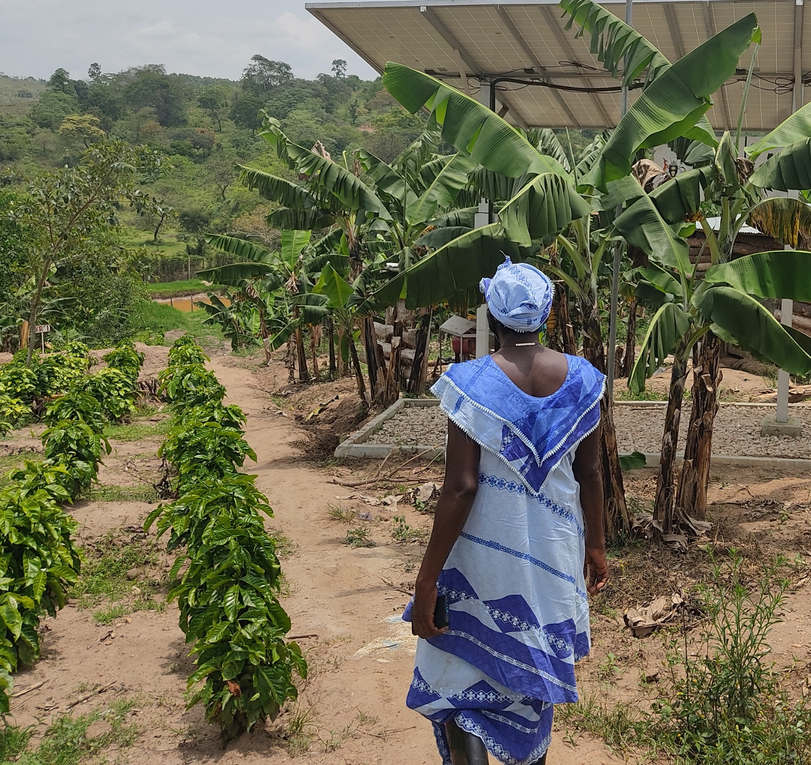
Aceli TA Program Overview

Slide 2
Capital Supply ≠ Demand
“Agri SMEs are too risky. There are few bankable SMEs” ̴ Lenders
“Lenders don’t understand our needs. Their processes and lending terms are unfavorable” ̴ SMEs

Slide 3
Why does this gap exist?
Data findings: Challenging economics of agricultural SME lending
2X Higher Risk
4-5% Lower Return
0%
0%
Loss Rates
Ag
Other
Sectors
Other
Sectors
Returns
Ag

Slide 4

What is Aceli Africa?
An incentive facility building the market for agricultural SME lending
Data-driven
Market-level
Impact-aligned

Slide 5














Demonstration model focused on East Africa
DONOR FUNDING
ACELI OFFERINGS
IMPACT – 2028, EAST AFRICA
$64m committed to date
Financial Incentives for lenders
Unlock $1B in lending
Technical Assistance for SMEs & Lenders
Improve livelihoods for 2 million smallholder farmers & workers
Data & Learning
Demonstrate scalable & replicable model

Slide 6



















TA Product Offering & Partners
Objective: Expand addressable demand for capital. Approach based on SME segment
01 - Cohort based
Earlier stage SMEs
02 - Customized
Growing SMEs
SME engagement partners

Slide 7
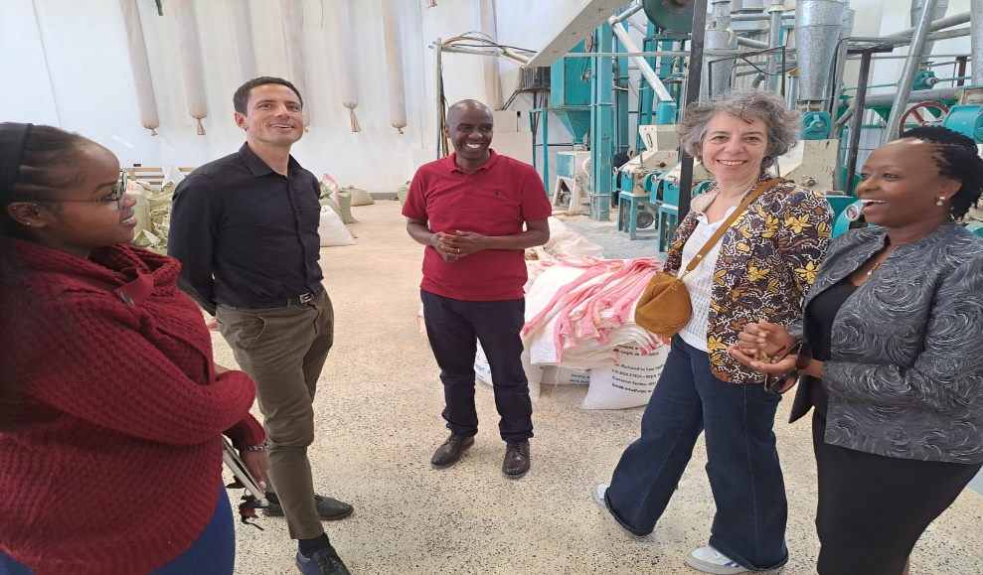
Highlights
136 Early Stage SMEs graduated. 22 Growing SMEs at various stages of support
KEY METRICS
FINANCE LINKAGE EXAMPLE – SOPA SUPPLIES LTD (KE)
78
4.7
5
NPS score for AMI/ WYLDE program. 50+ considered excellent
Average satisfaction rate (out of 5) for TechnoServe program
Average satisfaction rate (out of 5) for customized assignments
SAMPLE TESTIMONIALS
“I was surprised to discover that I didn’t know my business at all before this program! now our expenses are tracked, we conduct stock-taking and we understand our business numbers very well and can confidently present our business to investors and other businesses for collaboration.”
Bernard Alamiga Oku, Wonderland Farm Services-Smc Limited (Uganda)
“The programme was very well structured, the tools were very informative and interactive. The business practices have forced me to streamline our processes, coming up with standard operating procedures. We have reviewed our revenue streams and can now confidently say where are we making money from and who our target client is
Patricia Lagata, Horti Grid Ltd (Kenya)
Sopa completed the Growth & Investment Program in 2022 and 9 months later received a WC Facility of $195,000 from one of Aceli’s lending partners
SME Impact Areas:
Gender inclusion
Food Security & Nutrition
Youth inclusion

Slide 8
Key lessons
1
Strong correlation between screening and recruitment and successful engagement in the TA
2
Owners/ managers of early stage SMEs have limited bandwidth and capacity
3
  Introducing SMEs to lending partners isn’t sufficient

Slide 9
Strategies to scale, constraints and enablers
Aceli will rely on partners and explore innovative incentive models to achieve scale
Recruitment and screening – to identify high impact, investable SMEs that require that ‘last mile’ support
TA Delivery – to test approaches that build trust, foster transparency and motivation for the TA interventions
Matchmaking – to explore how to accelerate access to finance outcomes.
Constraints
Information asymmetry
SME mindset
High cost to serve relative to SME size
Enablers
Technology*
Local partners
Support from AMEA
Learning network
BDS market intelligence

Slide 10
For more information, contact:
rmidikira@aceliafrica.org

