Slide 1
(ABC) Agribusiness Cluster Training and Coaching
Presented by
Cees van Rij

Slide 2
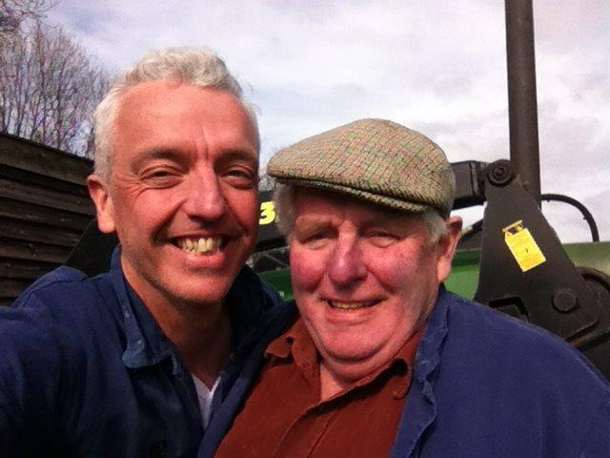
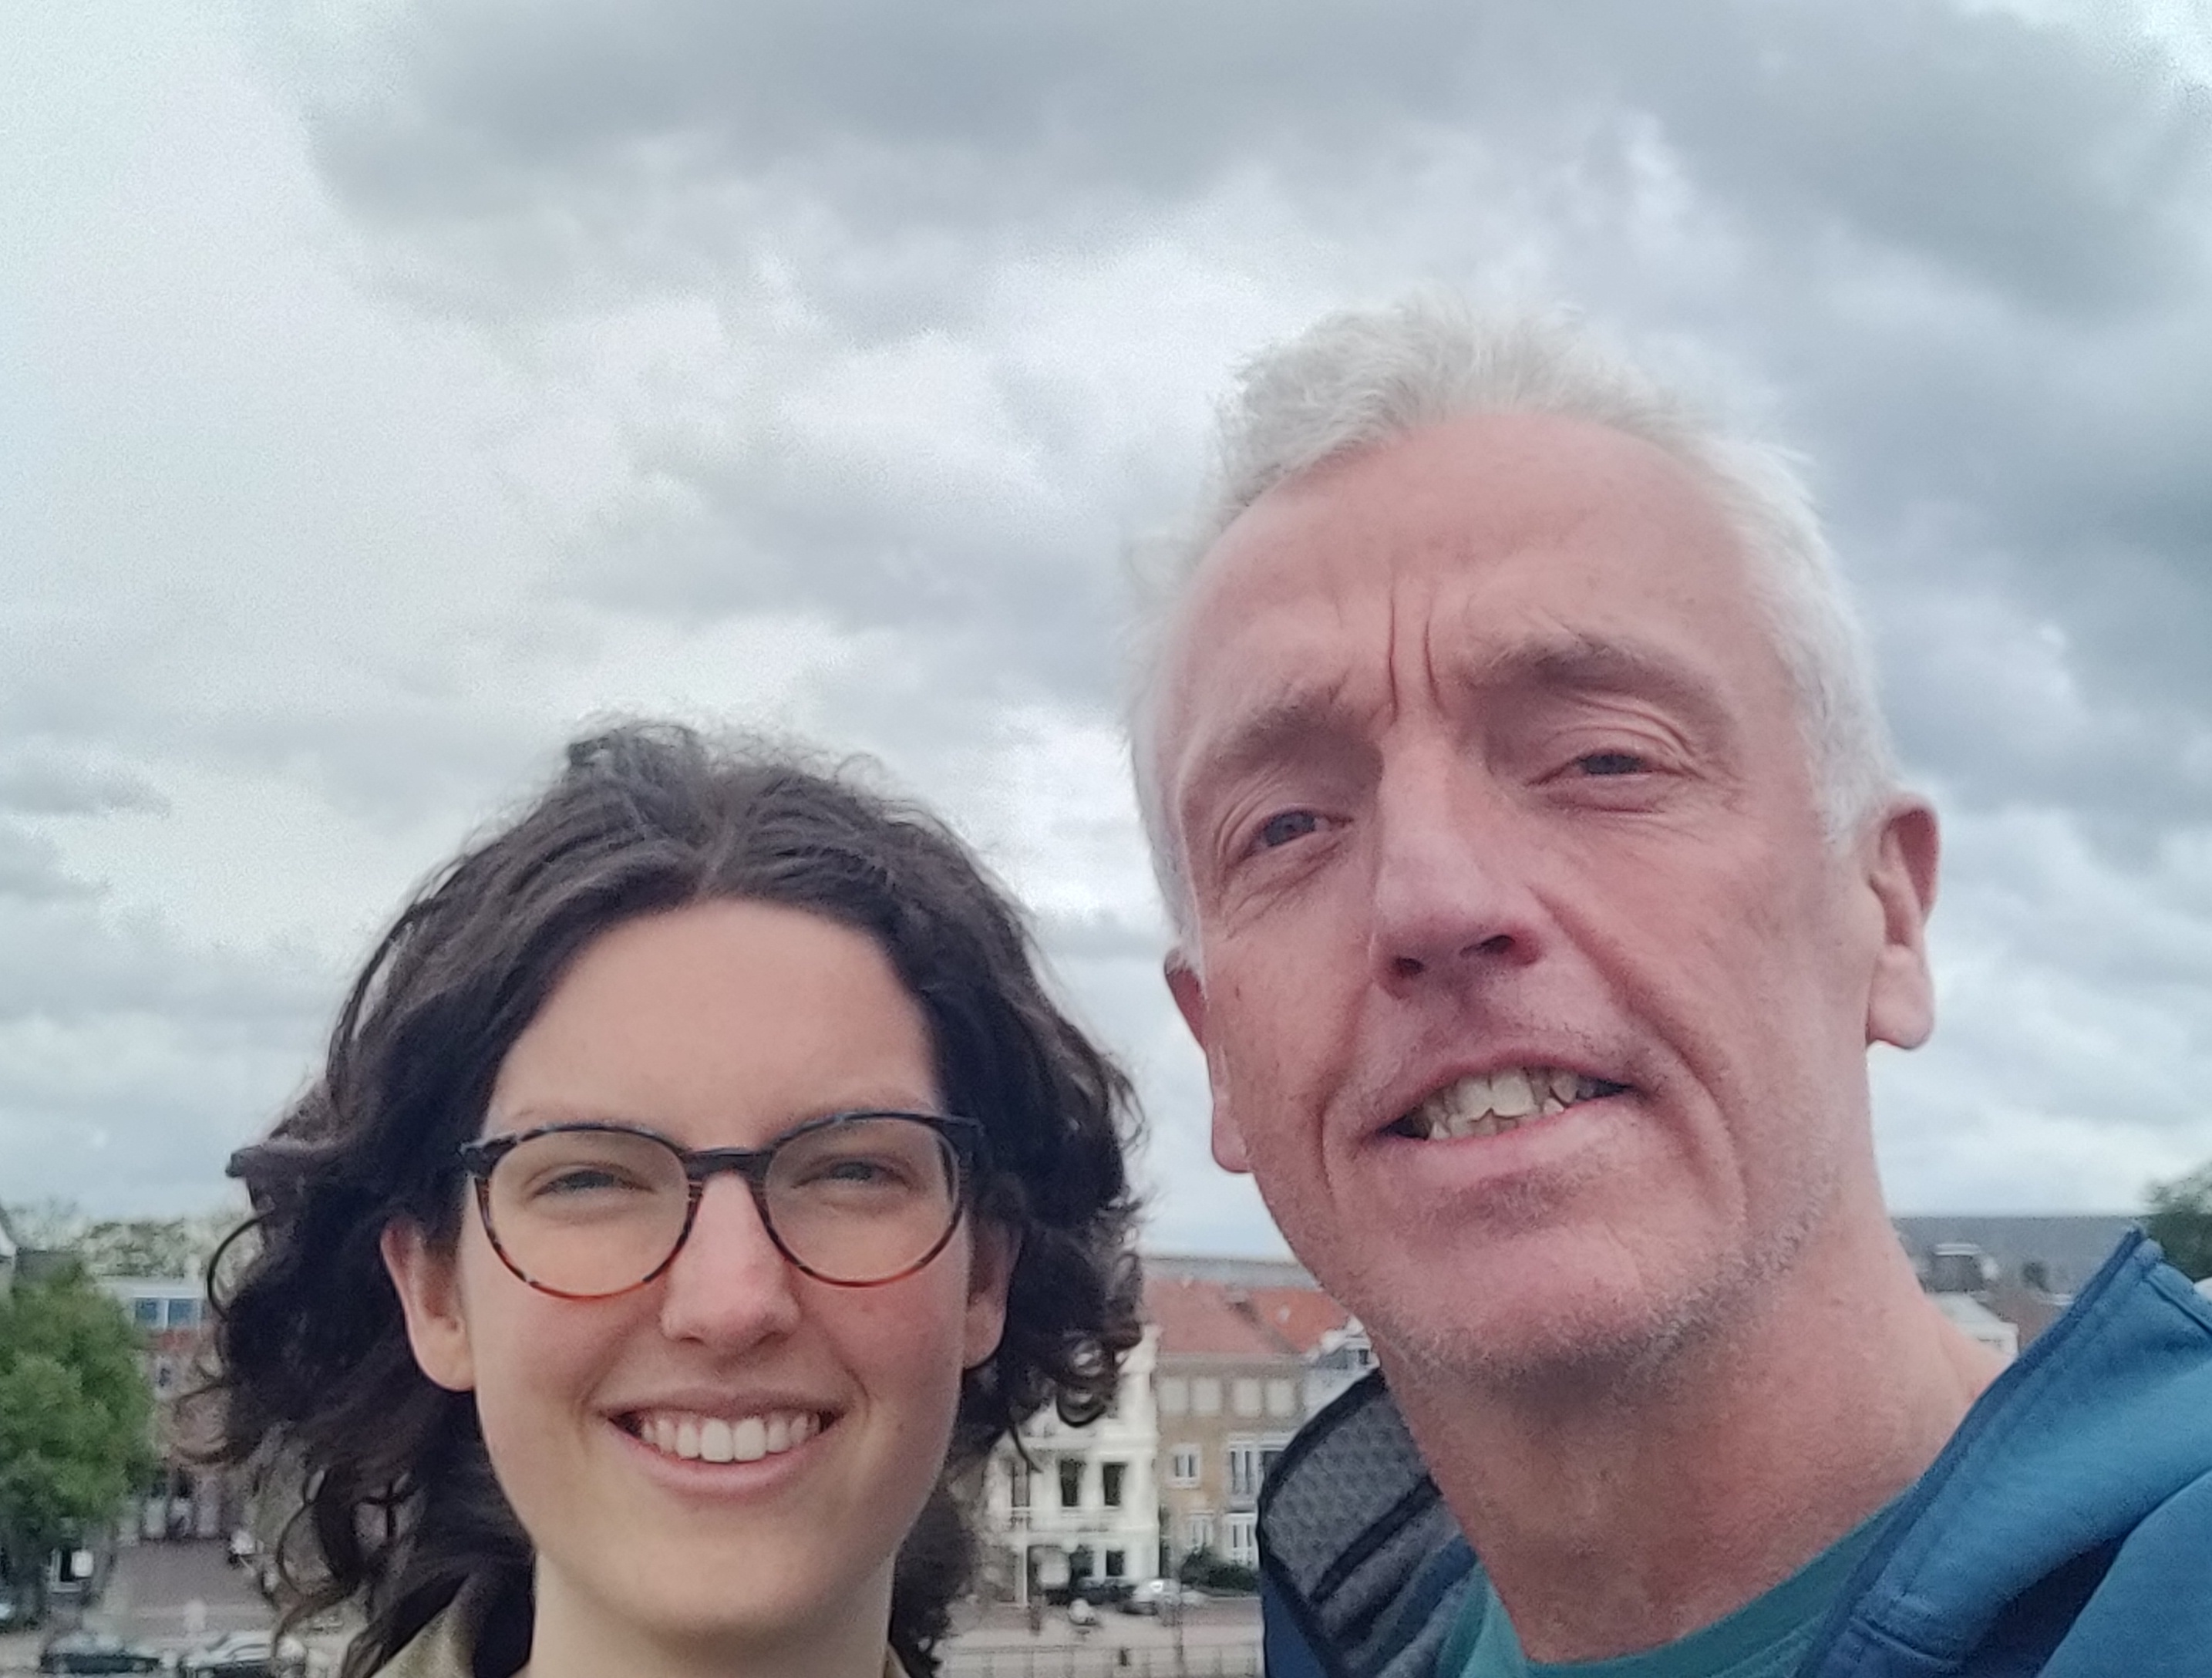

Who am I
Cees van Rij
55 years
Farmers’ son
Father of Toa
Husband of Wybren
Agriculture – Agribusiness
Fan of cooperatives
Agribusiness coordinator iCRA

Slide 3
Challenges in agri-food markets
Business relationships experience conflict
Small and medium enterprises have little bargaining power
It is challenging for actors to organise themselves horizontally
and build trusted vertical relationships with chain partners
Supply to offtakers is inconsistent, low in quality and sold at minimal profits
Service provision is often ad hoc and transactions costs are often high
Operational efficiency remains low

Slide 4
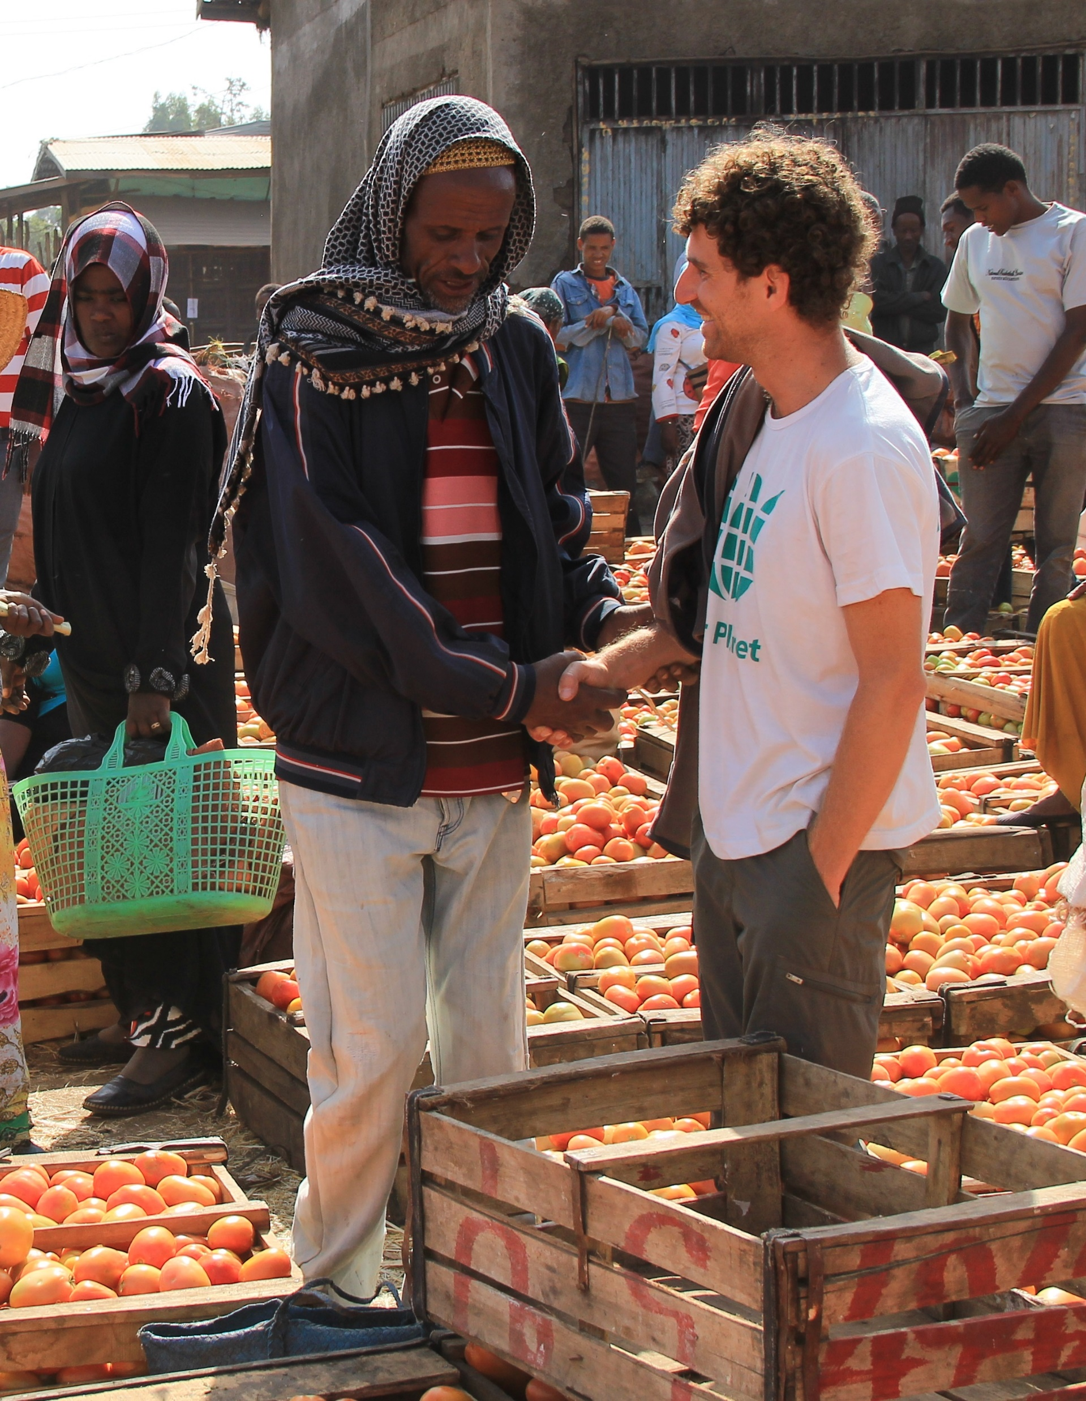
ABC enables..
Agribusinesses thriving in a successful local food market that:
Provide a good supply of high-quality product.
Gain a competitive edge through collaboration.
Benefit from trustworthy business partnerships.

Slide 5
Building trust in partnerships
“Not finance, not strategy, not technology.
It is teamwork that remains the
ultimate competitive advantage,
both because it is so powerful and so rare.”
- Patrick Lencioni –
‘The 5 frustrations of Teamwork’
Partnering skills are fundamental.
We believe in, and build, trusted partnerships between agribusiness actors.

Slide 6

ABC offers…
Facilitation tools to build trust between agribusiness actors.
People skills to facilitate agribusiness partnerships.
Practical skills to increase market value and competitiveness through collaboration.

Slide 7
ABC combines and links
Partnership facilitation skills
And
Market system thinking
Local agribusiness clusters
With
Value Chains

Slide 8
ABC Training and Coaching
Your gateway to thriving local food markets

Slide 9

ABC Characteristics
Varied agribusinesses and service providers
A local and informal ecosystem
Mix of actors
Local
Specific commodity
Cooperating to market a specific commodity and its end products.
Shared vision
Guided by a shared vision and competitive strategy
www.icra.global

Slide 10




The roles of ABC coaches
Networking and relationship mangement
Expert training and advising
Facilitating ongoing learning and action
Brokering and lobbying
Notes:
Icon Attribution:
Teamwork icons created by Becris – Flaticon
Opportunity icons created by iconixar – Flaticon
Presentation icons created by Freepik – Flaticon
Shout icons created by Freepik - Flaticon

Slide 11
ABC training modules
Competitive via collaboration
Building business relationships
Coaching towards vibrant ABCs
Financial education & analysis
Crop budgeting & planning
Inventory credit for products
Developing a business plan
ABC basics
ABC formation
Setting up business networks
Brokering in VC partnerships
Supporting rural organisations
Business Literacy
ABC coaching & facilitation
Stakeholder communication
Conflict management
Vertical coordination
Generating coaching income
Negotiation skills
Contract development
Loyalty engagements
Marketing agricultural products
Prospecting the market
Marketing & promotion
Deal making
Marketing
www.icra.global
Notes:
These tools are there for ABC trainers to equip cluster coaches

Slide 12
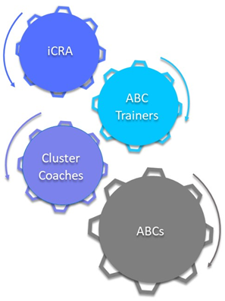
ABC as BDS model

Slide 13
Who is ABC trainer?
BDS provider. ABC as part of services portfolio.
ABC trainer makes an income out of the ABCs’ commodity business.
ABC trainer employed by Business Champion, such as a cooperative, aggregator, processor.

Slide 14
Market segment
Upstream: Agri SMEs, cooperatives, associations
Downstream: Business champion
BDS providers in food & agri

Slide 15



(Strategies to) Scale
Certification
Strategic collaborations
iCRA community/local partnerships

Slide 16
Constraints & Enablers
Access to finance
Digitalisation
Non-tangibility
Short-term investment > long-term impact
Stand-alone vs Embedded
Technology vs People

Slide 17
How can AMEA support
Eco-system/embedding

Slide 18
Connect with iCRA!

